Slide 1
Sai Vaishnavi Govindula Sai Rakesh Reddy Anumula Sai Bhargav Dasaraju Group No.2
INFO 5082

Slide 2
Weather Aware Traffic Sign Recognition System
This project pre-process the GTSRB dataset by implementing region-of-interest cropping, sign recognition normalization, and adding fog, rain, and glare augmentation. It has real-time, integrated weather metadata and achieves good frames per second for real-time inference. The pipeline prepares 39,209 images alleviating class imbalance for robust CNN and DNN training along with environments imbalances

Slide 3
Agenda
Title
Motivation
Background
Abstract(Problem statement)
Literature Survey
Objectives of the Study
Data Set and Data Processing
Research Design(Blueprint/Workflow)
Data Analysis and Model Description
Data Visualization and Results
Conclusion
References

Slide 4


Motivation
Traffic sign recognition is essential for autonomous driving and the safety of the roads.
Adverse weather conditions (e.g., fog, rain, glare) can degrade recognition accuracy.
Aim: Design a deep learning model with integrated weather metadata.
Dataset: German Traffic Sign Recognization System

Slide 5
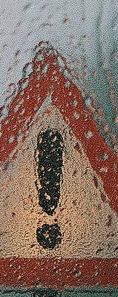
Background
Recognition systems heavily rely on image data only.
Weather-related visibility reduction results in misclassification by CNNs.
Other studies ignore weather; this research adds it as a parameter.
Include temperature and humidity data in the model.

Slide 6
Abstract
Recognition of traffic signs becomes problematic in low visibility weather conditions. This directly affects the safety of fully autonomous vehicles. The purpose of this research is to increase the accuracy of weather monitoring AI systems through the use of image data. A novel weather-aware traffic sign recognition deep learning model is developed to enhance performance in poor weather conditions. A hybrid CNN-DNN architecture is constructed by simulating weather influences on the GTSRB dataset and incorporating real-time weather data. The proposed model demonstrates effective accuracy and real-time performance, rendering it practical for autonomous driving in various weather conditions.

Slide 7
Literature Survey
Adhikari et al. (2024) focused on improving traffic safety during adverse weather by implementing machine learning systems that can anticipate and prevent risks.
Zhou et al. (2022) introduced an adaptive deep learning approach for traffic sign detection that adjusts to varying visual conditions, enhancing model flexibility.
Jaiswal et al. (2023) validated the accuracy and reliability of weather APIs to ensure trustworthy integration into real-time transportation systems.
Yang et al. (2024) proposed a lightweight CNN-based model to improve the efficiency and speed of traffic sign recognition in resource-constrained environments.
Kim et al. (2023) utilized Generative Adversarial Networks (GANs) to generate synthetic images simulating foggy and rainy conditions, improving model resilience.

Slide 8
Objectives of the Study
Extract and preprocess GTSRB.
Simulate fog, rain, glare.
Integrate weather via API.
Build hybrid CNN-DNN model.
Evaluate accuracy, FPS.

Slide 9
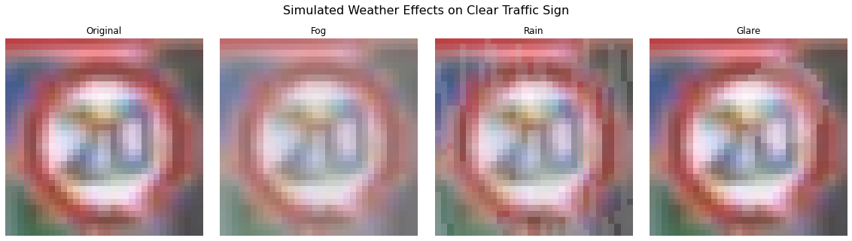
Data Set and Data Processing
Dataset: GTSRB (39,209 images, 43 classes).
Preprocessing: Resize, crop using ROI, normalize.
Class distribution summarized in DataFrame.
Applied rotation, zoom, flip, brightness changes, and noise to improve model robustness. Simulated rain and fog to train under adverse weather conditions.

Slide 10
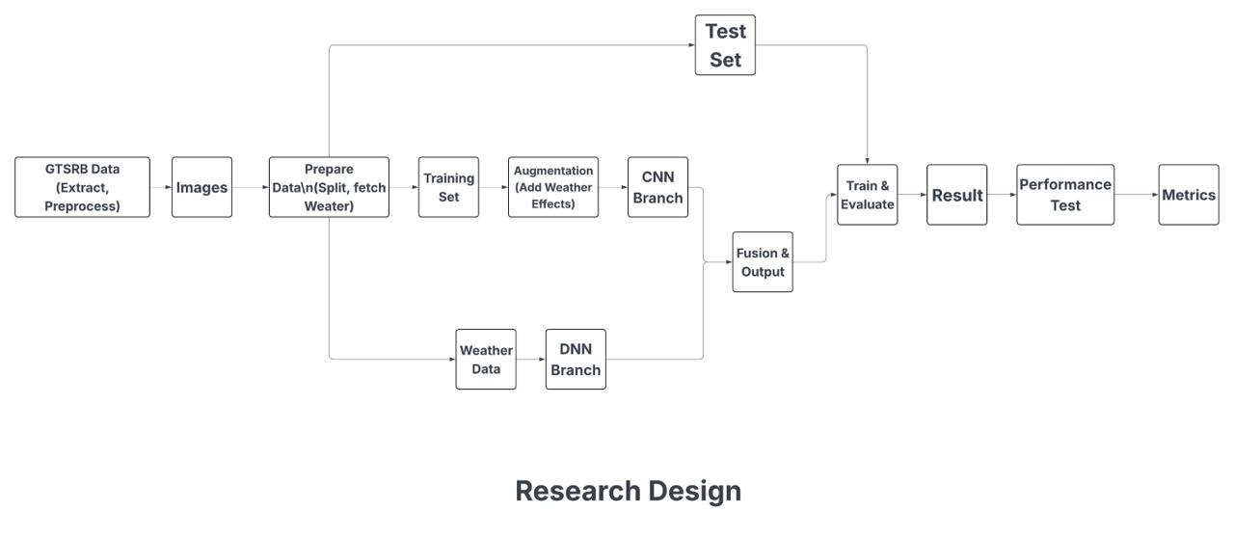
Research Design

Slide 11
Data Analysis and Model Description
CNN: Conv2D, MaxPool, Flatten, Dense(128), Dropout(0.5).
Weather: Dense(8) for metadata.
Fusion: Concatenate, Dense softmax(43 classes).
Train with Adam, 10 epochs, batch size 64.

Slide 12
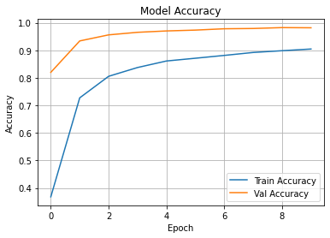
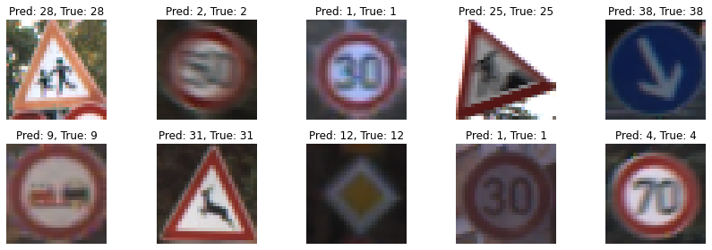
Data Visualization and Results
Accuracy and loss curves (train vs. val).
Final Accuracy: 99
Classification Report: Precision, recall, F1.
Confusion Matrix heatmap.
10 sample predictions (predicted vs. true).

Slide 13
Conclusion
Built a weather-aware traffic sign recognition model with 99 percent accuracy.
Simulated weather effects (fog, rain, glare) improved robustness.
Real-time weather metadata enhanced performance.
Achieved high FPS (2117.28 for 4 frames with 100 iterations)

Slide 14
References
Aziz, S., & Youssef, M. (2018). Traffic sign recognition based on Extreme Learning Machine and feature extraction techniques. 2018 International Conference on Computer and Applications (ICCA), 232–237.
Gurumurthy, S., & Karthikeyan, V. (2023). A lightweight convolutional neural network (CNN) architecture for traffic sign recognition in urban road networks. Sensors, 23(5),
Madani, A., & Yusof, R. (2023). Enhanced traffic sign recognition with ensemble learning. Applied Sciences, 13(6), 3984.
Sermanet, P., & LeCun, Y. (2024). Optimized detection and classification on GTSRB: Advancing traffic sign recognition with convolutional neural networks. arXiv.
Weng, J., & Chiu, C.-C. (2019). Improved traffic sign detection and recognition algorithm for intelligent vehicles. IEEE Access, 7, 168506–168517.
Sreya, G., Asha, V., & Amrutha, K. (2021). Recent advances in traffic sign recognition: Approaches and datasets. Procedia Computer Science, 192, 2489–2498.
Zaibi, A., Ladgham, M., & Sakly, A. (2021). A lightweight model for traffic sign classification based on enhanced LeNet-5 network. Journal of Sensors, 2021, 1–13.
Manik Das Adhikari Ji-Myong Kim and Sang-Guk Yum. Development of a deep neural network-based life accident evaluation model for weather-related railway accidents. KSCE Journal of Civil Engineering, 28(10):4624–4638, 2024.
Yixun Zhou Junguo Liao and Qiangqiang Qin. An adaptive traffic sign recognition scheme based on deep learning in complex environment. IEEE Intl Conf on Parallel Distributed Processing with Applications, Big Data Cloud Computing, Sustainable Computing Communications, Social Computing Networking, 2022.
Vishal Jaiswal Suraj Singh, Vivek Patel and Shivam Yadav. Weather forecasting using api: A comparative study, 2023.
Chunyu Yang Yuan An and Shuo Zhang. A lightweight network architecture for traffic sign recognition based on enhanced lenet-5. Frontiers in Neuroscience, 18:1431033, 2024.

Slide 15
Thank You

